Slide 1
Universities Rankings
How is the ranking done? What are the criteria? Are there different rankings?

Slide 2
Problem Statment
A. Which universities are ranked in the top 10 globally?
B. Which universities are ranked in the top 10 for employment outcomes?
C. What positions do universities in Saudi Arabia hold within the global
rankings?
D. Considering various factors such as employment rankings, research
rankings, and others, which has the most significant impact on a
university's overall ranking?
E. Is there a correlation between national and global university rankings, and
based on this information, can you recommend a country that appears to
have a high concentration of top-ranked universities?

Slide 3
Ranking References
Academic Ranking:
Shanghai Rankings
THE CENTER FOR WORLD UNIVERSITY RANKINGS
Impact Ranking:
Times Higher Education Rankings

Slide 4
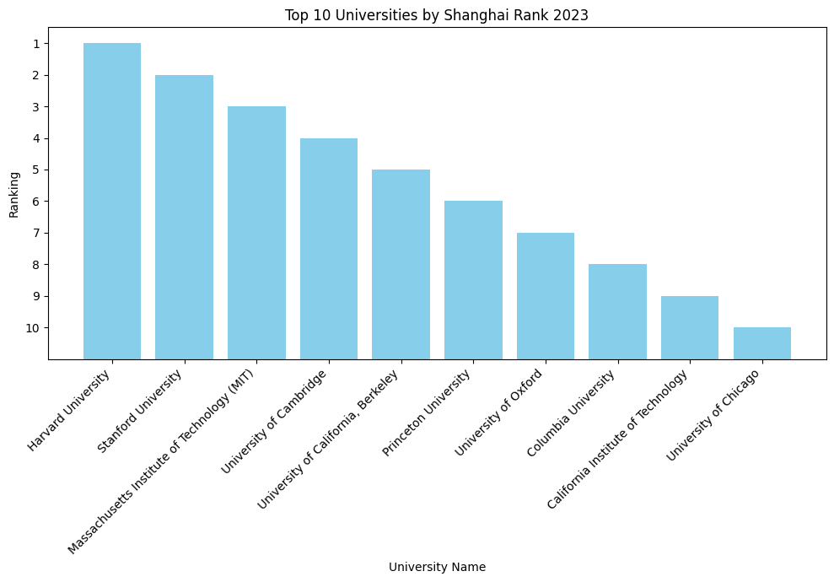
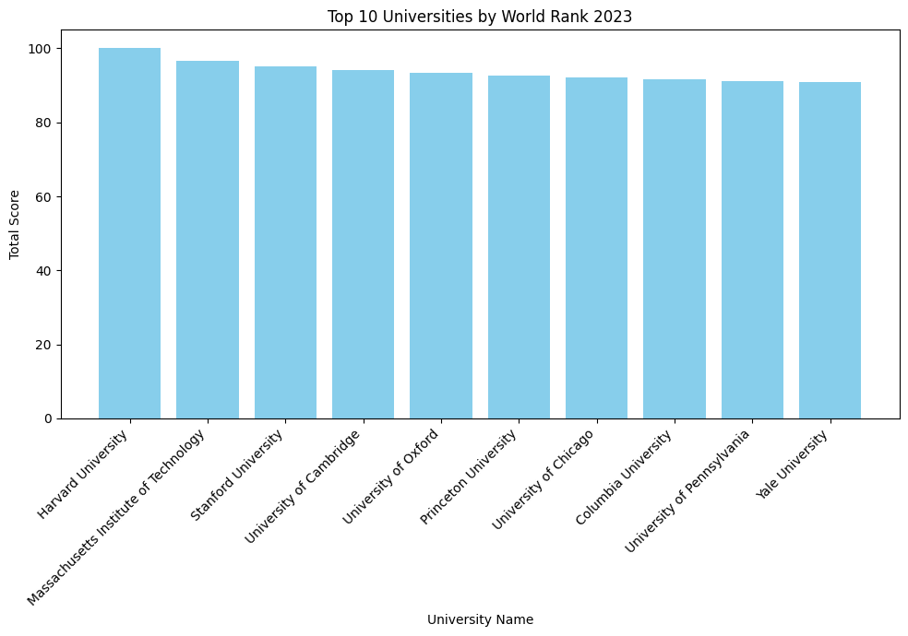
TOP 10

Slide 5
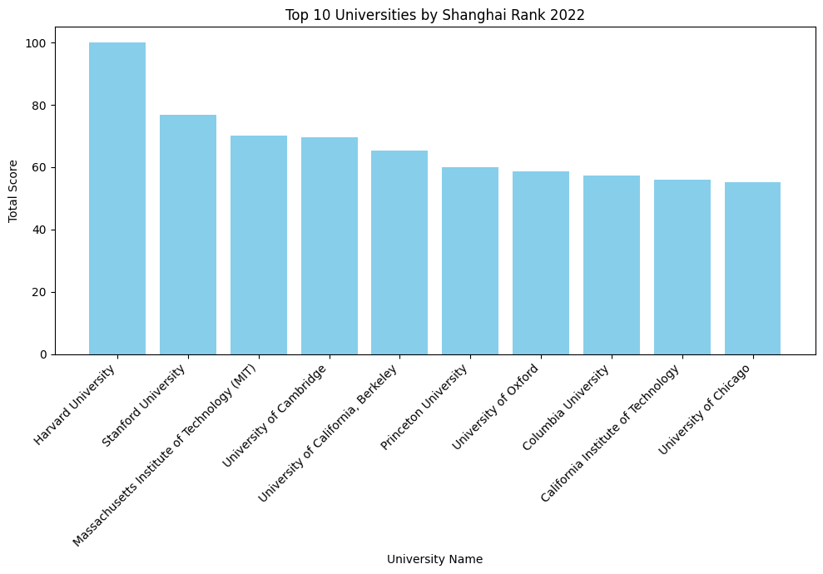
TOP 10

Slide 6
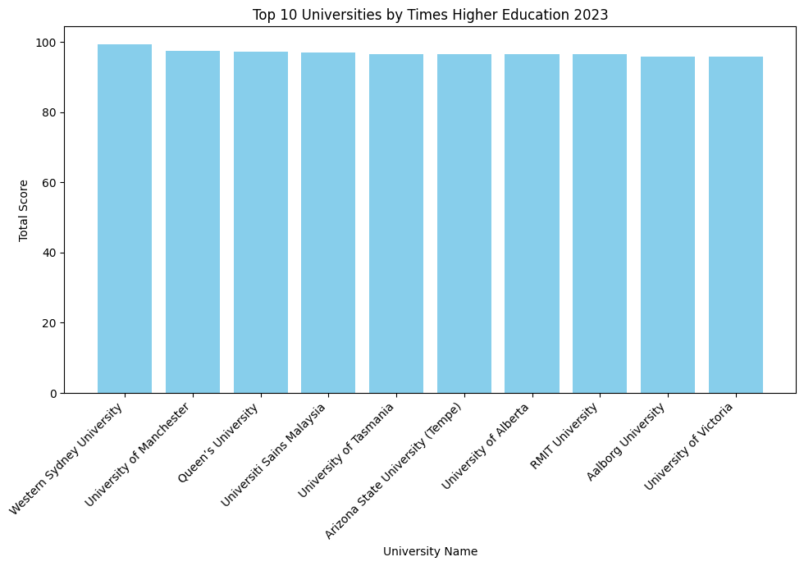
TOP 10

Slide 7
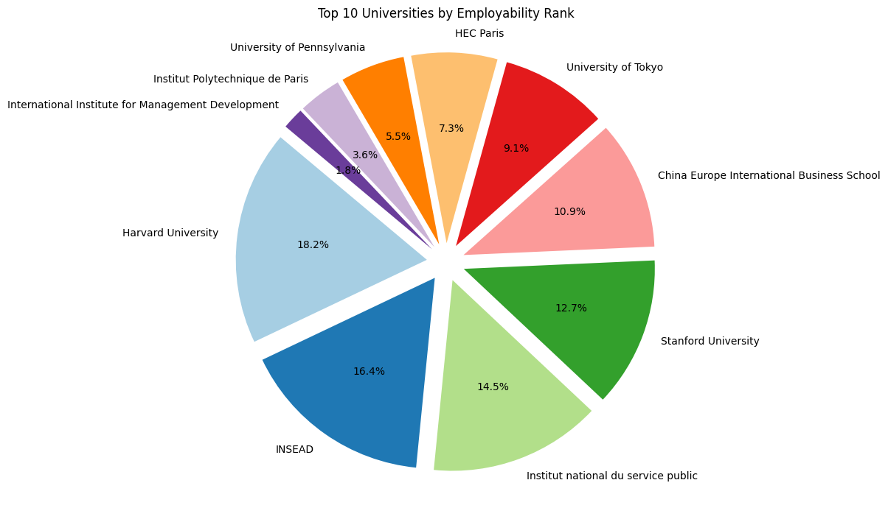
Employability Rank

Slide 8
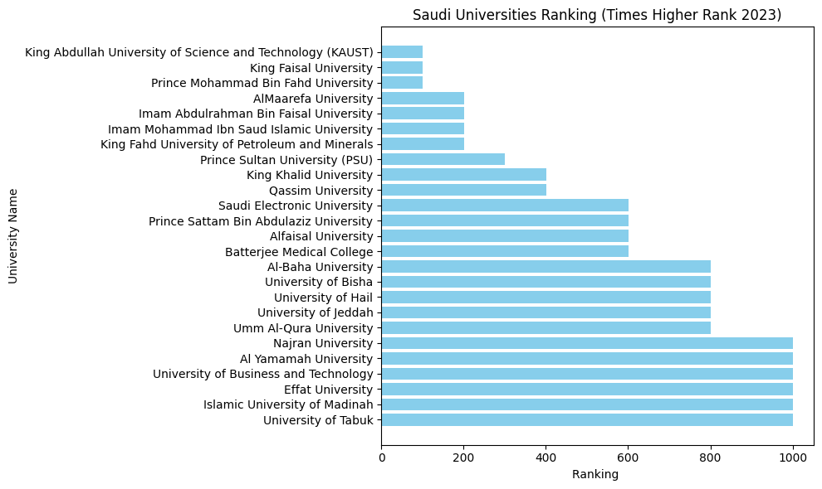
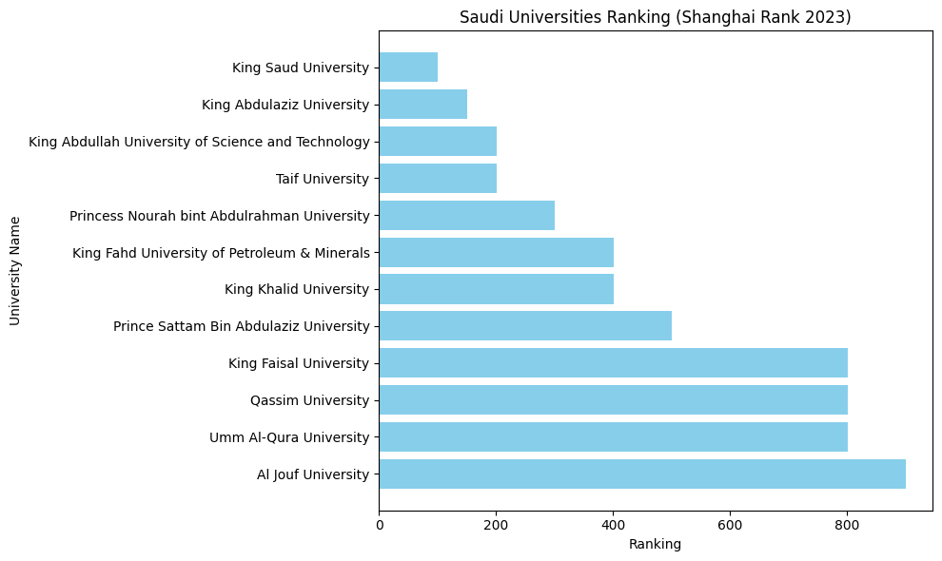
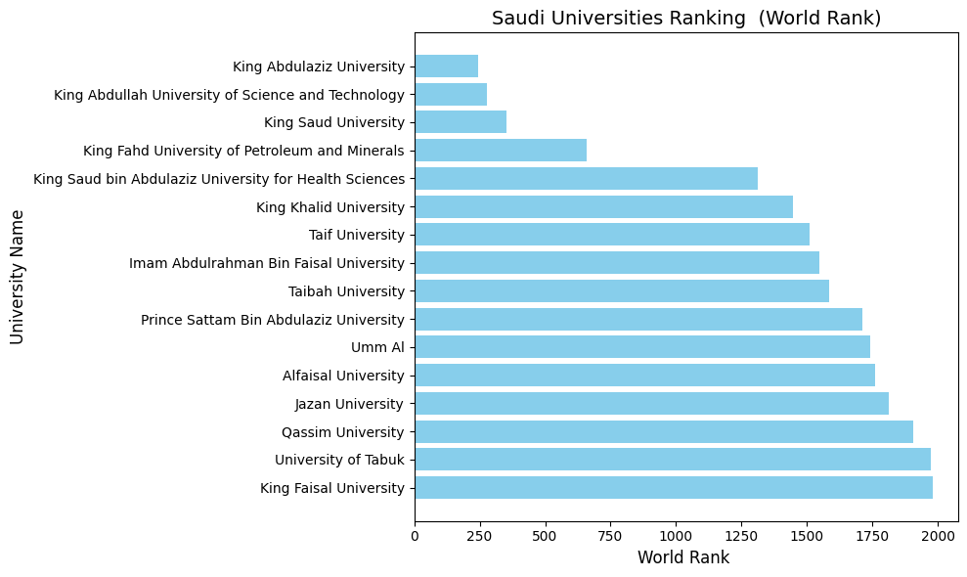
Saudi Universities Ranking

Slide 9
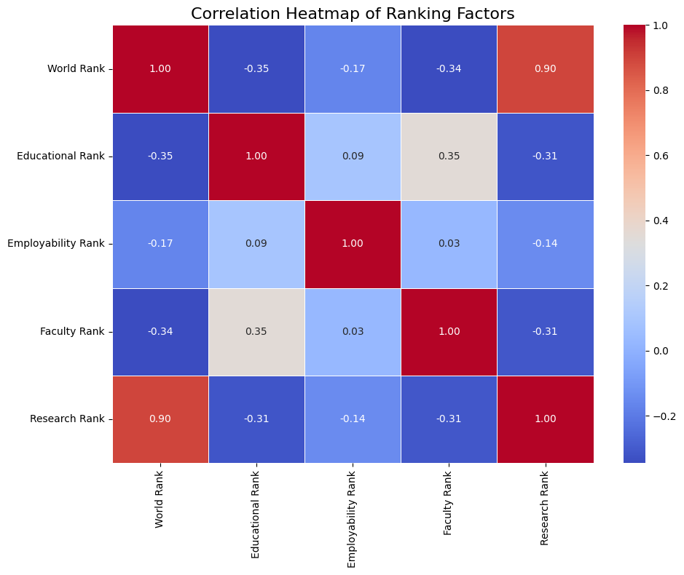
The Factors Impact

Slide 10
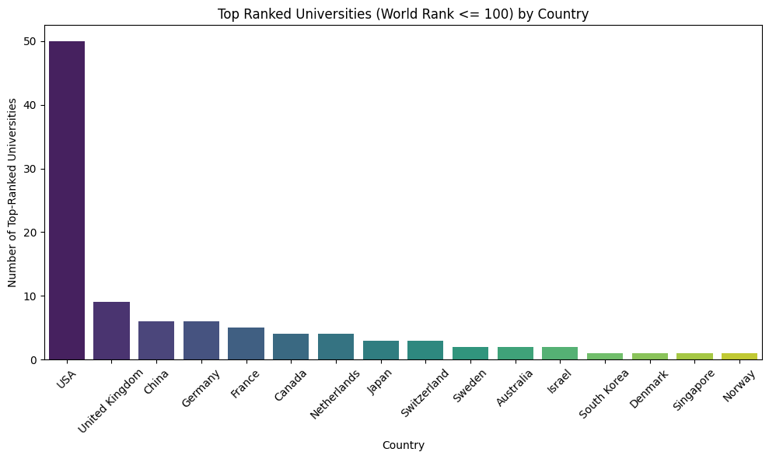
Correlation between global and national rank
Moderate National-World Rank Correlation (0.35): National rankings only moderately correlate with world rankings, indicating local and global criteria differ.

Slide 11
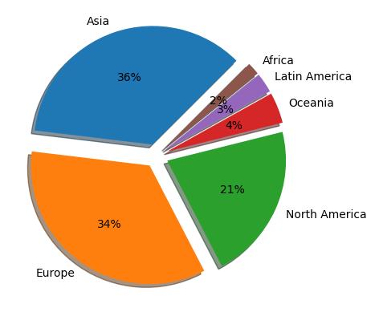
Global Distribution of Universities by Region (Shanghai 2023)

Slide 12
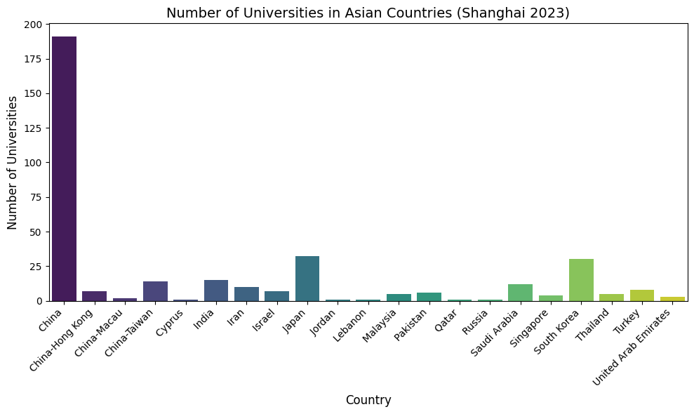
Global Distribution of Universities in Asia (Shanghai 2023)

Slide 13
Conclusions
Our analysis shows that U.S. universities dominate global rankings, with Harvard, Stanford, and MIT leading due to strong research output and faculty achievements. Employability rankings are more diverse, with top performers from France, Japan, and Australia. Saudi universities, led by King Abdulaziz University and KAUST, are rising in global rankings. Research rank has the strongest impact on the overall ranking, emphasizing its importance. China leads Asia in the number of ranked universities, reflecting rapid growth in higher education. These insights help guide students, researchers, and policymakers in academic decisions.

Slide 14
Thank you!
Ahmed Alhassar
Emtnan Alomireni
Naser Almanaa
Rahaf Alotaibi

